Slide 1


TL500VT: DEVOPS CULTURE AND PRACTICE Enablement
Welcome & Course Introduction

Slide 2


Topics
Participant Profiles
Who should attend the course?
Course Goals and Objectives
What will I get out of this course?
Agile Practices
Introduction of multiple DevOPS and Agile practices and ceremonies used throughout the project lifecycle focusing mainly around outcomes and non-technical components of the project.
Technical Hands-On Exercises
Designed to immerse users in a typical DevOPS pipeline using a variety of tools. This portion of the course will focus more on delivery section of a typical DevOPS process as well as the technical tools that can be used for create a DevSecOps or other automated workflow.
Tools to be Used
Miro - Used for Agile practices and exercises as well as maintaining project schedule and documentation. Virtual whiteboard that can simulate a room for walking-the-walls.
Google Meet - Used for video conferencing and facilitation of participants
OpenShift/Jenkins/Gitlab/Tekton/Helm - Used for hands-on technical exercises as well as other tools.
Discord – Used for video conferencing, persistent chat, and facilitation of participants
Notes:
https://www.redhat.com/en/services/training/tl500-devops-culture-and-practice-enablement?section=Overview

Slide 3
Course Participants
NORTH AMERICA - November 2019 All-Hands Call
Notes:
Accessing Student VMs through Workstation Port Forwarding
Accessing Student VMs through Bastion Port Forwarding

Slide 4




Course Participants
Product Owners
Developers
Immersive course experience to mimic real-world projects and delivery teams. Product owners will be able to participate and share in all aspects of the delivery cycle and be exposed to the technical practices used to deliver products..
Developers will experience both sides of the loop from discovery to delivery and will become embedded as part of a larger team. This will allow full integration in the feedback loop and create a more cohesive team.
Engineers / Administrators
New Team Members
Integration with cross-functional teams bringing the administrators closer with the developers and development process along with integrating them earlier in the feedback loop.
TL500 blends Agile and DevOps practices into a highly engaging experience requiring participation from all team members. New team members can not only learn DevOPS and Agile practices, they naturally build relationships among team members as part of the exercises

Slide 5
Goals
&
Objectives
NORTH AMERICA - November 2019 All-Hands Call
Notes:
Instructor ToolKit
MOJO - New Site
RHLC
Knowledge management
RHU ROL / public ROL

Slide 6
Goals and Objectives
Leverage Hands-On Technical Tools
Leverage Hands-On Tools for Practices
Pairing and mobbing will be used to assist with hands-on technical exercises. Not all users will feel comfortable completing the exercises, but it is more important to understand the process rather than completing the exercise. It will develop perspective and give insight into the full discovery and delivery process.
Learn the use of Miro and other online tools that can assist with running remote exercises for gathering information in discovery sessions and other Agile practices.
Network of Resources
Team Building
Add to your existing library of resources around DevOPS and Agile. Learn more about the Open Practice Library and how to leverage additional practices in your journey.
Build confidence and trust working as an integrated DevOPS team. Leverage various practices that make it easier for members of different sections of the team to work more efficiently together.
Learn
Learn to use and leverage the practices throughout the week. More importantly take the practices back and see which work best in your work environment. Additional Goals and Objectives will be based on information obtained from the Target Outcomes practice.

Slide 7
Practices
NORTH AMERICA - November 2019 All-Hands Call

Slide 8
Practices
Hands-On Activities
Presentation-Based Activities
Social Contracts
Pairing and Mobbing
Definition of Done
Target Outcomes
Retrospectives
Parking Lot
Walk-the-Walls
Priority Sliders
Impact Mapping
User Story Mapping
Event Storming
Test Driven Development
Metrics Based Process Mapping (MBPM)
Secondary Learning
Affinity Mapping
Kanban
Miro
Various Videos

Slide 9
Technical
Hands-on
Exercises
NORTH AMERICA - November 2019 All-Hands Call

Slide 10
Technical Hands-On Exercises
Hands-On Activities
Configuration-as-Code (CaC) and Infrastructure-as-Code (Gitlab)
Pipelines (Jenkins/Tekton)
Containers and Orchestration (OpenShift)
Container Registries (Nexus)
Automation/GitOps (ArgoCD)
Local development environment (CodeReady Workspace)
… and more

Slide 11
TL500
Tools
NORTH AMERICA - November 2019 All-Hands Call

Slide 12

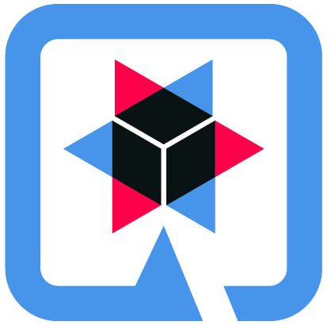



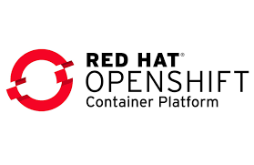





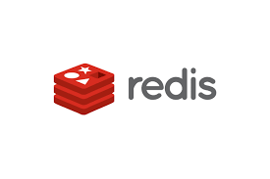












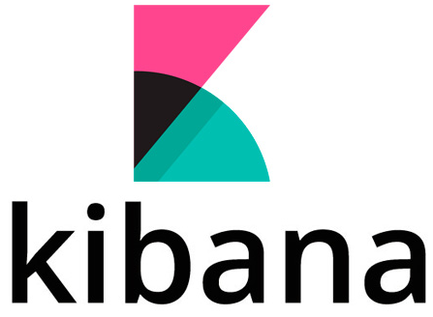
TL500 Tools

Slide 13
Discord Overview

Slide 14
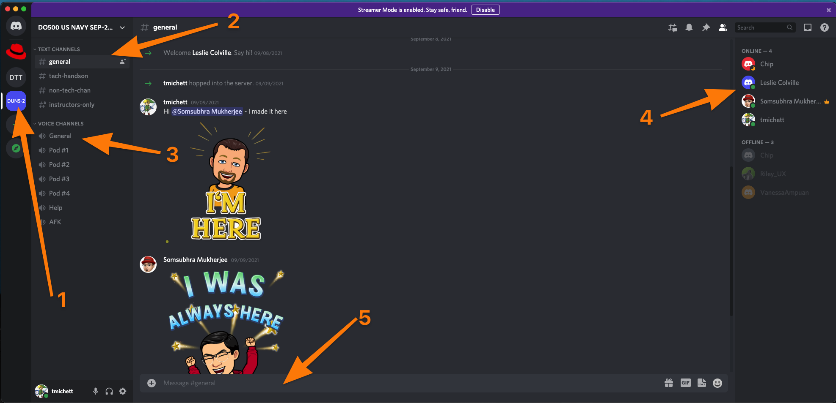
Discord Interface
Key
Discord Server – Hosts all chat and video conferencing for session.
Discord Chat Channel – Text-based chat similar to slack.
Discord Voice Channel – Channels used for video conferencing
Discord Online Members
Discord Chat Input
Use the “General” VOICE CHANNEL

Slide 15
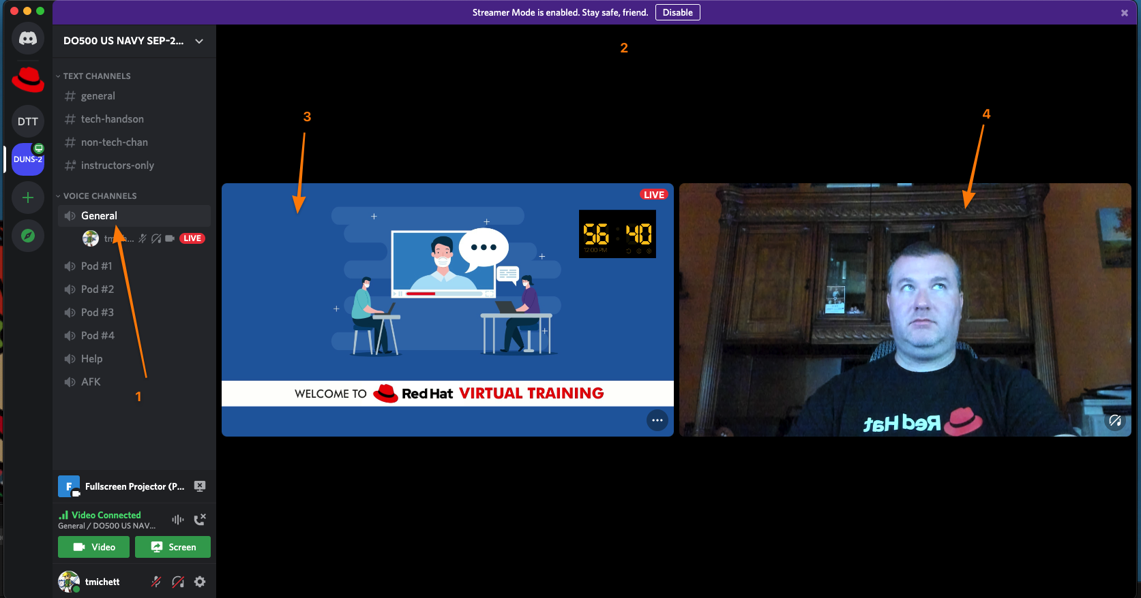
Discord Interface – General Voice Channel
Key
Current voice channel.
Discord Voice Channel Streams
Screen Sharing Stream
Participant Video Stream

Slide 16
Discord Interface – General Voice Channel
Key
Current voice channel.
Discord Voice Channel Streams
Screen Sharing Stream
Participant Video Stream

Slide 17
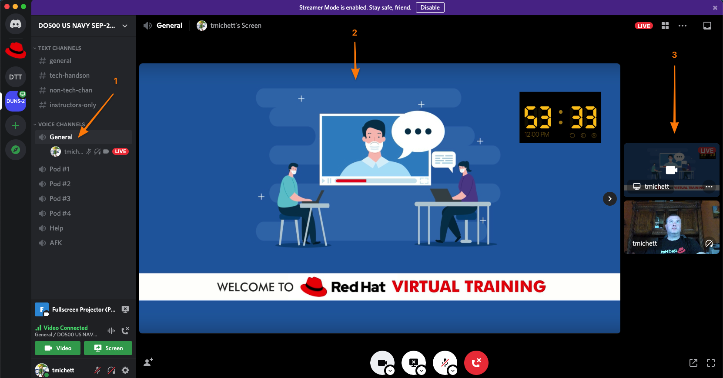
Discord Interface – General Voice Channel
Key
Current voice channel.
Discord Selected Stream (Video or Sharing)
Remaining Discord Streams

Slide 18
Discord Overview

Slide 19
Miro Overview

Slide 20
MIRO Demo

Slide 21
Thank you
Red Hat is the world’s leading provider of enterprise open source software solutions. Award-winning support, training, and consulting services make Red Hat a trusted adviser to the Fortune 500.
E-Mail: tmichett@redhat.com

